Slide 1

How does a bike share navigate a speedy success?
Presented by: Callum thickett
Last updated: 27/10/2021

Slide 2
Table of contents.
The presentation objective
Research and findings
A summary of our finings
Solutions and next steps.
appendix

Slide 3
Objectives.
To understand the key differences between casual and annual members.
To use these new insights to form a strategy to convert existing casual customers to annual members.

Slide 4
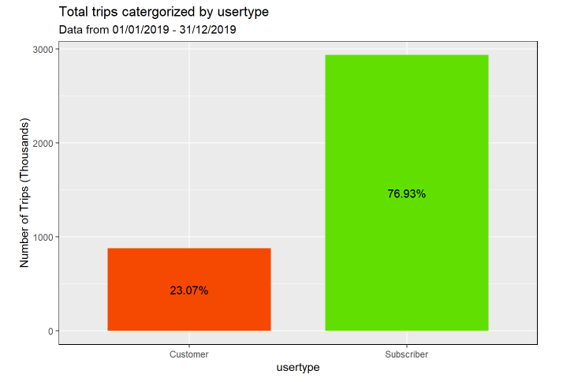
The current userbase.
76% of all trips are by Subscribers.
This is not to say that 76% of all users are subscribers.
Total trips for 2019: roughly 3.8million.
Notes:
Based on data given, this is our best metric for determining the spread of usertype
Need to lower the customer portion and raise the subscriber portion.
Further data needed to get an accurate spread.
Following on: most popular stations

Slide 5
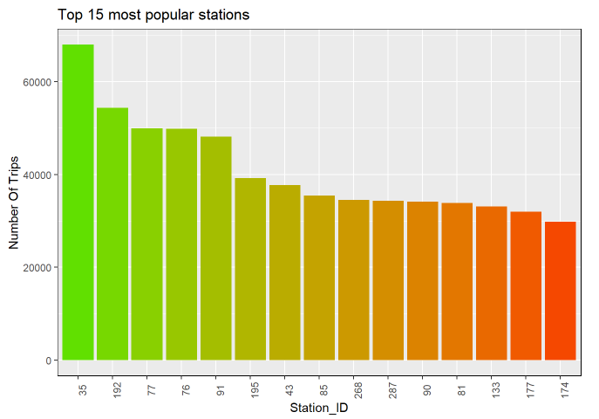
Most popular stations.
640 Total stations
Number of total trips quickly falls off.
Notes:
Next up: same but for customers

Slide 6
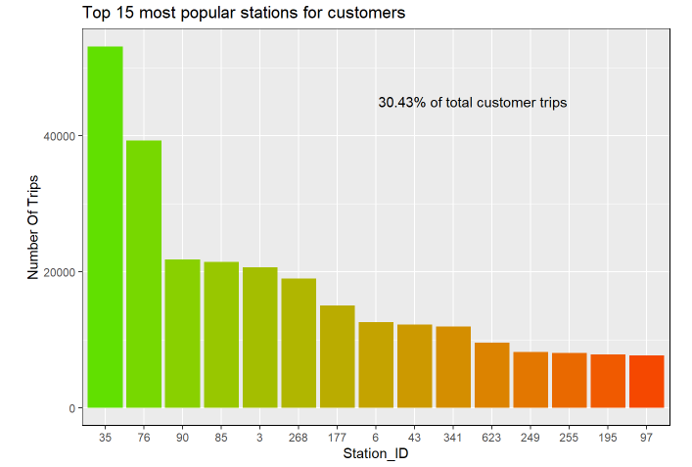
Most popular stations – Customers.
Most popular overall station is majority customer based.
30% of total customer trips are from these 15 stations alone.
35 and 76 alone make up over 10% of total customer trips.
Notes:
This data is using start locations only.
Clearly something special about 35 and 76. need to look further into these.
Next up: journeys

Slide 7
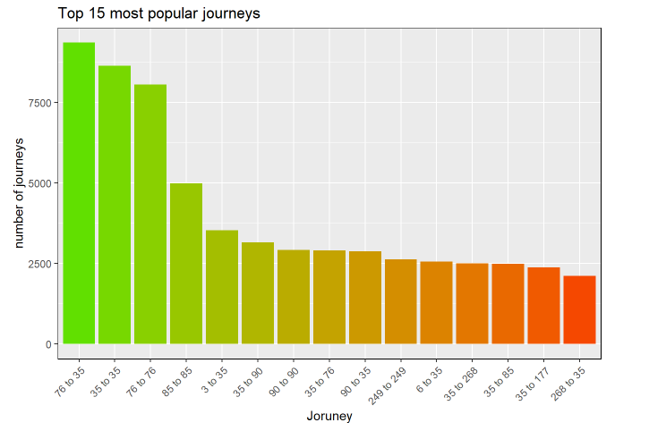
Most popular journeys – Customers.
Top 3 most popular journeys include stations 35 and 76 exclusively.
Majority of top 15 journeys either start or end at 35.
Notes:
Clearly something special about 35 and 76. need to look further into these.
Next up: take a look at geographical data of the stations.

Slide 8
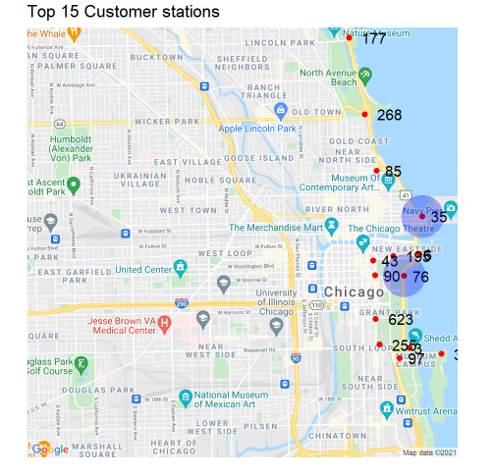
Is location the key?
All 15 Locations along the waterfront or around a park.
35 is located right on the pier front.
76 is located between grant park and the waterfront.
Prime tourism locations.
Notes:
All of top 15 on the water front or around parks.
Next up: take a look at geographical data of the stations.

Slide 9
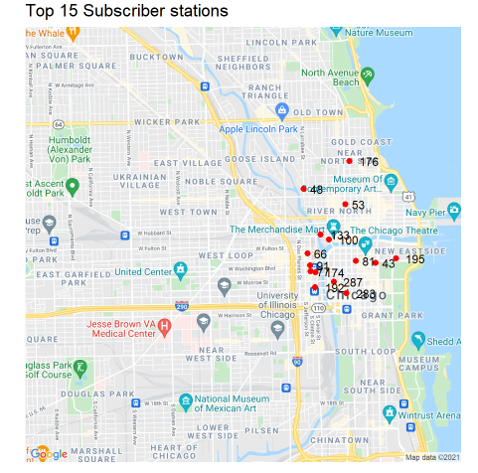
Is location the key?
All 15 Locations are inner-city
Stations more clumped together
Notes:
All 15 are more inner-city. Journeys more distributed.

Slide 10
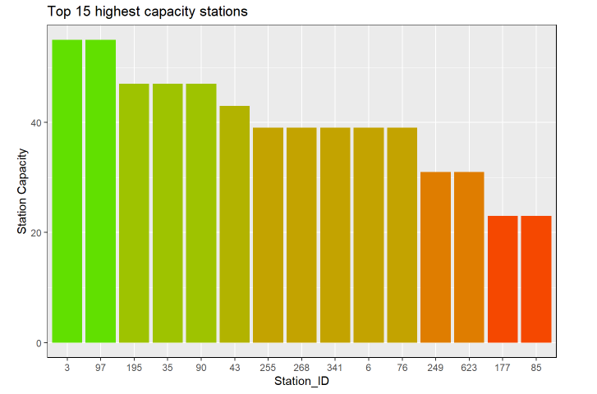
Does station capacity have an effect?
Seems like station capacity has little effect
Many of the more popular stations don’t have a noticeably high bike capacity.
Bike capacity doesn’t seem to bottleneck any locations.

Slide 11
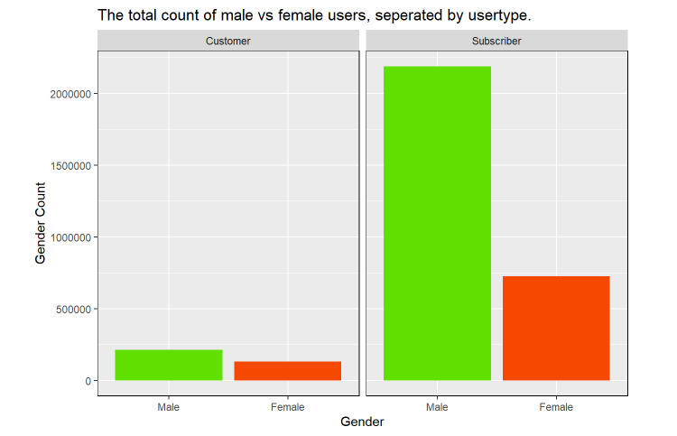
Gender and Age deep dive.
38% of all customer trips are female.
Only 24% of all subscriber trips are female.
Notes:
Low conversion rate on women specifically.

Slide 12
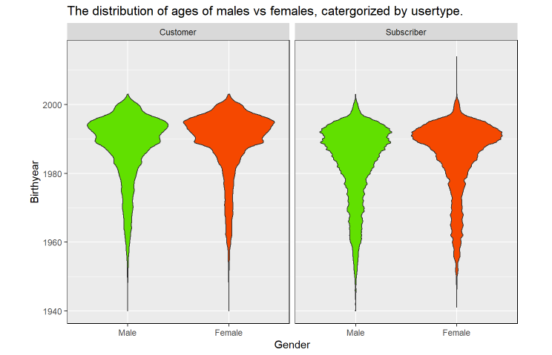
Gender and Age deep dive.
In general, customers tend to be younger, irrespective of gender.
In general, female users tend to be a little younger than males.
Notes:
Now were also factoring in birthyear.

Slide 13
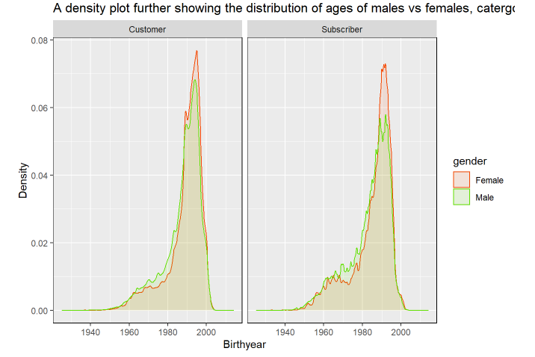
Gender and Age deep dive.
Females are less distributed with regards to age.
Notes:
Now were also factoring in birthyear.

Slide 14
A summary of our findings.
Station and Trip Findings:
A large portion of Trips come from a very small number of stations.
This is especially true for customers.
Popular customer stations are located mainly on the sea front, or in popular tourist locations i.e parks.
Gender and Age Findings:
Majority of users are male.
Females have a lower chance of subscribing than males
Customers tend to be younger, on average than Subscribers.
Males have a more even distribution of ages than females.

Slide 15
Next Steps.
Further analysis required on the importance of station location (look at all stations, not just the 15 most popular)
Further analysis required on the importance of season/time of year and the effects it has on subscriber numbers and journey types.
More information on specific users either through a randomized survey to get geographical data on housing/work locations. Could help to see if there are areas in the cities where new stations could be added.
Add an anonymized user_ID tracker for subscribers. Allow to see specific journeys anonymously to see user habits, could help better see the differences between subscribers and Customers.

Slide 16
Solutions.
Goal: To use these new insights to form a strategy to convert existing casual customers to annual members.
Market strategies focused at young men and women aged 22-30.
Marketing strategies focused at women.
Create more incentives for tourists/visitors to become subscribers.

